Slide 1

A Flexible Schedular for Single-Processor Embedded systems for Arduino UNO
Presented BY Mohamed Gamil & Kareem Yasser & Abdelrahman Elsayed
Supervised BY DR.Rami Zeweil

Slide 2

Introduction

Slide 3

Introduction
Cooperative Scheduler

Slide 4
Overview

Slide 5
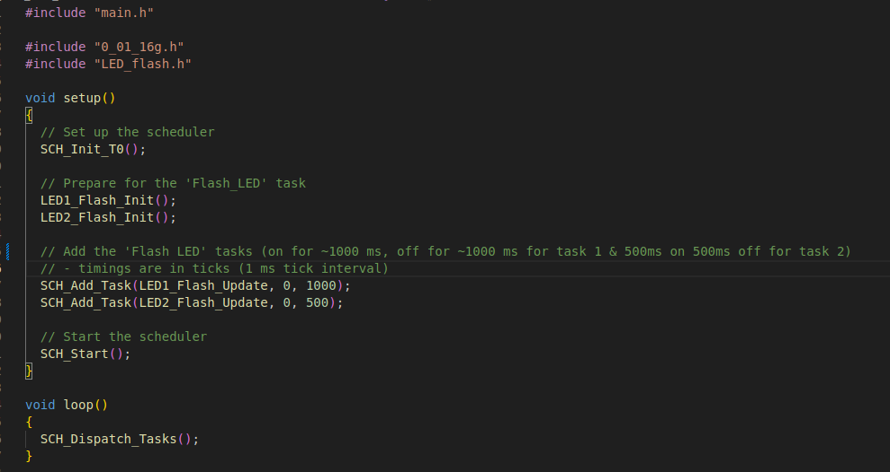
Overview
Main code

Slide 6
Scheduler Data Structure

Slide 7
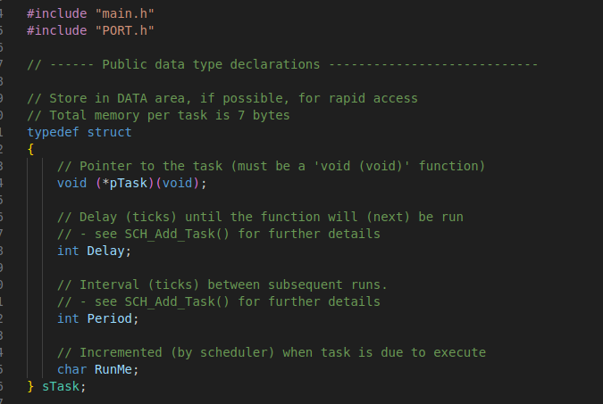
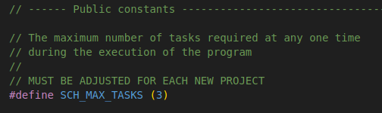
Scheduler Data Structure
SCH328P.h

Slide 8
Scheduler Data Structure
SCH328P.h

Slide 9
Thank You

